Slide 1

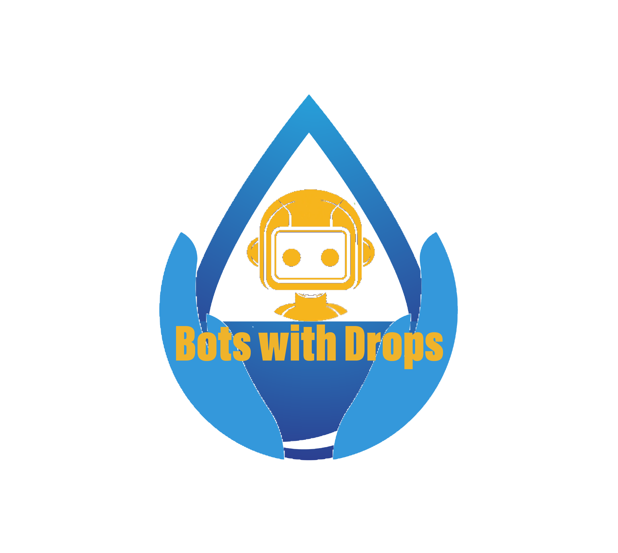

Xylem watermark project
team: BOTS WITH DROPS
Saroja kandula Ravikiran Mohan Talekar
Cheerudeep Chintha Harinder Singh Koranga
Sahar Zannoun simon gensler
coding for humanity

Slide 2
Agenda
Goals
Idea
Solution
Achievement
Future Implementations

Slide 3
goal
To provide Information and Educate 2,000,000+ people worldwide
Water resource data
Clean water availability
Motivation to save water
Instructions and Best Practices

Slide 4
Xylem – ”Intelligence Operation Center”
Responsibilities:
Identify Target audience Ex: City, village, Popular locations
Aggregate statistical data Town/City/Region/Country
Create real time Dashboard
Maintain Dashboard in runtime
IDEAS

Slide 5
Dashboard Content
Percentage of water:
Utilized
Comparision
Availability
Potential Savings
Instructions and Best practices to save water

Slide 6
Database Storage Ex: BigQuery
Log Aggregation Ex: Stackdriver
Monitoring Ex: SignalFx
Visualization Ex: Grafana
TECHNICAL SOLUTIONS

Slide 7
DEMO IN DATA STUDIO
PDF

Slide 8
ACHIEVEMENT
Outreach
Awareness
Motivation
Improvement
Identify Challenges

Slide 9
Future Implementations
Rating/Badge to region based on success factor
Various stats information
Dynamic Best Practices and Instructions
Analyze non-performing regions

Slide 10

Xylem watermark project
team: BOTS WITH DROPS
Saroja kandula Ravikiran Mohan Talekar Cheerudeep Chintha
Sahar Zannoun Harinder Singh Koranga simon gensler
coding for humanity

Slide 11
Q&A?
THANK YOU

